Slide 1


Insight: Financial Report Analysis Engine based on LlamaIndex
CS6493 NLP Final Project
Completed by Wang Hongyuan, Zhang Jiajun, Wang Yixin

Slide 2

CONTENTS
01
Project Background & Tech Stack
• The Challenges of Financial Analysis • Why RAG? • Tech Stack: The Engine Room
02
System Architecture & Core Modules
• System Architecture Overview • Data Ingestion & Retrieval • Generation Engine & UI
03
Evaluation & Experiment Results
• Localized RAGAS Evaluation • Experiment Results
04
Conclusion & Future Work
• Key Contributions • Future Directions

Slide 3
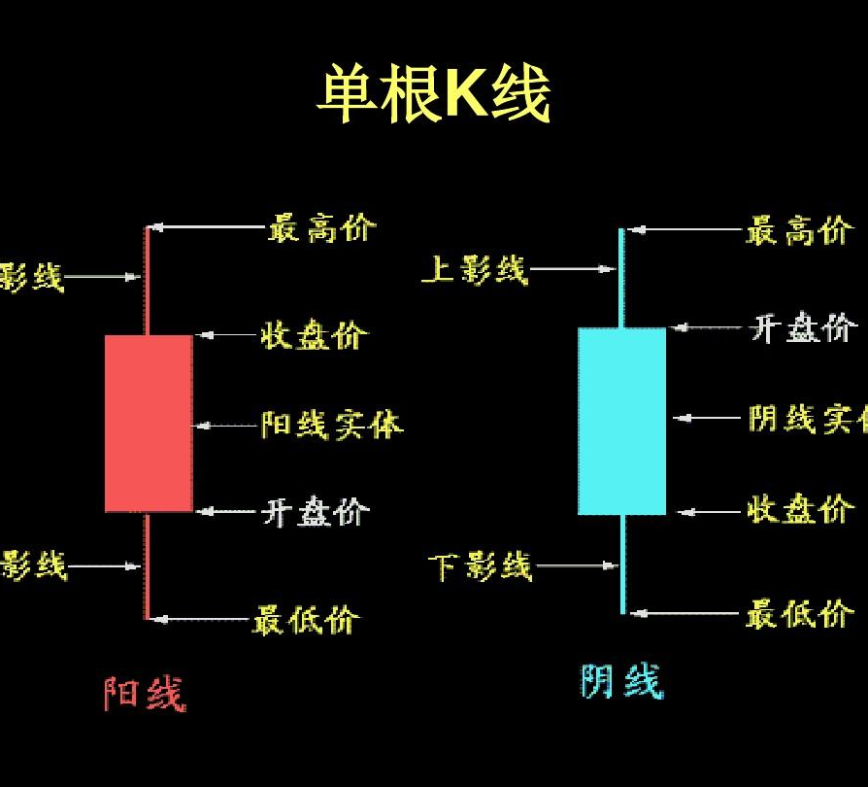



01. The Challenges of Financial Analysis
Information Overload & Efficiency Bottlenecks
High Demand for Timeliness
Data Privacy & Security

Slide 4



01. Why RAG over Fine-tuning?
Knowledge Update Instantaneity
Cost-Effectiveness
Reduction of Hallucination

Slide 5


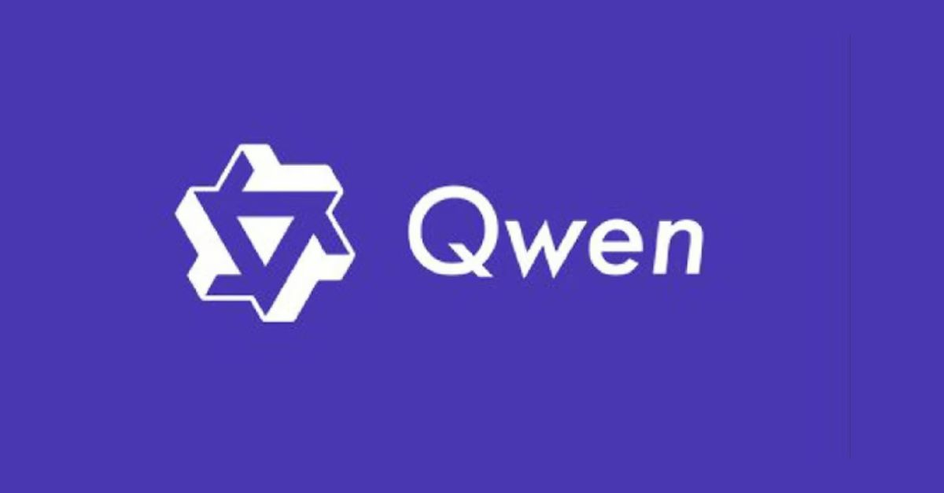

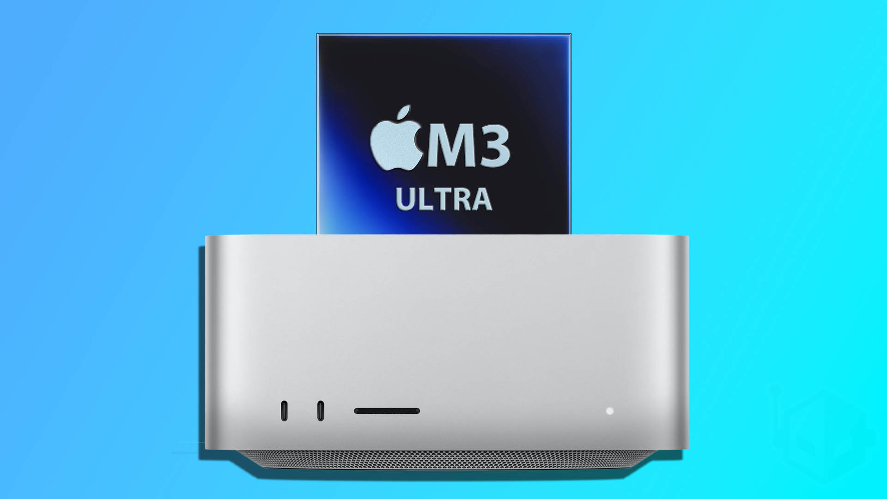
01. Tech Stack: The Engine Room
Core Framework
• LlamaIndex v0.10+
Foundation for orchestrating data pipelines and connecting to LLMs.
Vector Database
• ChromaDB
Lightweight, in-memory DB for storing and retrieving vector embeddings efficiently.
AI Models
• Qwen2.5-7B (Gen) / 72B (Eval) • Embedding: BGE-M3 • Reranker: BGE-Reranker
Pipeline & Interface
• Frontend: Gradio • PDF Parsing: PyMuPDF • Evaluation: RAGAS
Hardware Infrastructure
• Apple Mac Studio M3 Ultra 512GB RAM & MPS Acceleration for fast local inference.

Slide 6
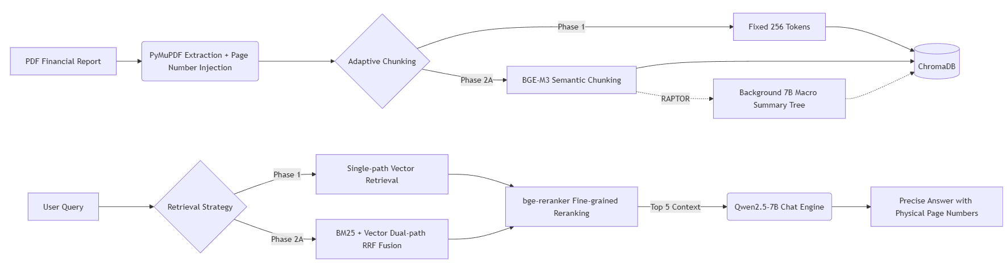
02. System Architecture Overview

Slide 7


02. Data Ingestion & Retrieval
Data Ingestion Optimization
Retrieval Strategy Optimization
•Metadata Contract: Enforce source and page_label for full traceability of every generated response.
• Chunking Strategy:Utilize semantic chunking (BGE-M3) to preserve logical coherence, which is critical for causal reasoning tasks.
• RAPTOR Index:Construct a hierarchical knowledge structure to support efficient macro summarization across large documents.
• Hybrid Retrieval:Combine the strengths ofvector search(capturing semantic similarity) andBM25(lexical keyword matching) to achieve more robust and comprehensive recall.
• Engineering Optimization:Implement a global singleton cache for the BM25 inverted index matrix and Reranker model, enabling zero-latency reuse and significantly faster overall system response times.

Slide 8

02. Generation Engine & UI
🛡️ Triple Defense Against Hallucination
1. Strict Source Constraint Prompt mandates answers only from provided excerpts.
2. Graceful Refusal Model states inability to answer if context is insufficient.
3. Proactive Conflict Detection Flags and presents conflicting data from multiple sources.
📑 Citation & Audit
Forced Citations Every answer includes[Source: filename, Page X]to trace origin.
Citation Audit Module Intercepts 97% of fake citations, ensuring data authenticity.
🖥️ Immersive Gradio UI
A three-panel layout designed for seamless user experience: • Document Management • Chat & Evidence Display • One-click PDF Source Jumping

Slide 9

03. Evaluation & Experiment Results

Slide 10

03. Localized RAGAS Evaluation Loop
🤖 LLM-as-a-Judge
📊 Core Metrics (0.0-1.0)
🧪 Experimental Design
To ensure an impartial and robust assessment of system performance, we leverage the high-performance Qwen2.5-72B model as an automated judge. This model evaluates the quality of generated outputs against a set of predefined standards.
1. Context Precision: Measures how relevant the retrieved context is to the original question.
2. Faithfulness: Determines if the answer is factually grounded and consistent with the provided context.
3. Answer Relevancy: Assesses the degree to which the generated answer directly addresses the question.
Gold Test Set: A curated set of 20 diverse questions, covering Factoid Extraction, Causal Reasoning, Macro Summarization, and Structured Artifact Generation.
Ablation Study: Comparative analysis across three distinct system configurations: Baseline, Advanced, and Ultimate.

Slide 11



03. Experiment Results
03. Experimental Results & Analysis
Quantitative Results
Strategy Analysis
Verifiability Metrics
Context Precision: Baseline (0.82) → Ultimate (0.91)
Faithfulness: Baseline (0.78) → Ultimate (0.88)
"The results show clear, measurable gains from each optimization strategy implemented."
• Baseline: Struggles with macro summarization due to rigid, fixed chunking.
• Advanced: Significant improvement across all question types, particularly in causal reasoning.
• Ultimate: Establishes an absolute advantage in complex macro summarization tasks.
• Citation Jump Success Rate:96%(Target ≥ 95%)
• Citation Page Accuracy:92%(Target ≥ 90%)
• Fake Citation Interception:97%(Target ≥ 95%)
"All metrics consistently meet or exceed preset quality assurance targets."

Slide 12




04. Key Contributions
End-to-End Integration
Successfully built a complete RAG system with a closed-loop workflow, seamlessly connecting the stages from document ingestion to retrieval-augmented generation and comprehensive system evaluation.
Technical Innovations
• Adaptive Semantic Chunking & Dual-path Hybrid Retrieval • RAPTOR Hierarchical Summarization for complex reasoning • Page-level Citation & Traceability for answer trustworthiness
Localized Evaluation System
Established a fully offline "LLM-as-a-Judge" system for reliable performance measurement. It enables us to rigorously assess the quality of generated answers, relevance of retrieved documents, and overall system accuracy.
Complete Analyst Workflow
Delivered a user-friendly Gradio frontend that supports a seamless experience from initial Q&A to evidence verification and source exploration, fully aligning with the needs of professional analysts.

Slide 13
04. Future Directions
Multimodal Capabilities
Extend the system to understand and analyze charts, graphs, and tables in financial reports.
Real-time Data Integration
Connect to live data sources like Yahoo Finance or Bloomberg for dynamic market context.
Personalized Recommendations
Intelligently recommend relevant report sections or analysis angles based on user history.
Multilingual Support
Extend support to analyze reports in Chinese, English, and other languages.
Domain Expansion
Apply the technical framework to other vertical domains like healthcare, law, and technology, broadening the scope of document intelligence applications.

Slide 14

Thank You for Listening!

